Slide 1
Modeling and Control of iiwa 7 R800 Robotic Arm
Turki Haj Mohamad
5/10/2018

Slide 2
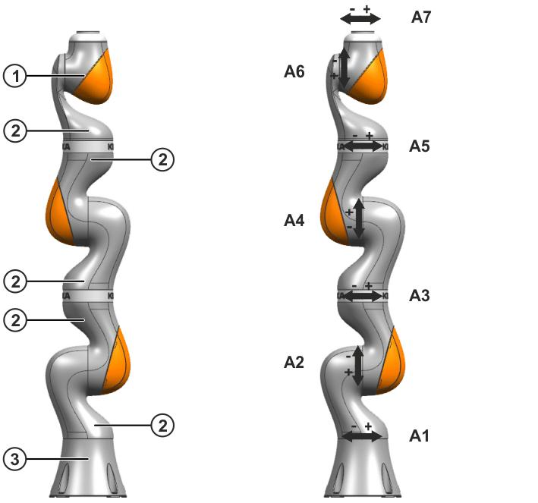

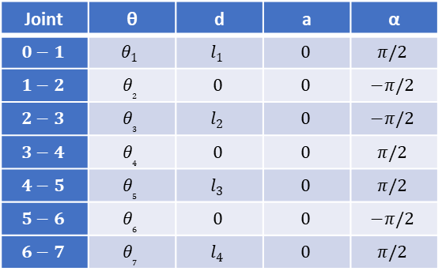



Z₇
Z₆
(b)
X₇
θ₇
(a)
$$l_{4}$$
Z₅
θ₆
X₅, X₆
Z₄
Joint | θ | d | a | α
$$0−1$$ | $$θ_{1}$$ | $$l_{1}$$ | $$0$$ | $$π/2$$
$$1−2$$ | $$θ_{2}$$ | $$0$$ | $$0$$ | $$−π/2$$
$$2−3$$ | $$θ_{3}$$ | $$l_{2}$$ | $$0$$ | $$−π/2$$
$$3−4$$ | $$θ_{4}$$ | $$0$$ | $$0$$ | $$π/2$$
$$4−5$$ | $$θ_{5}$$ | $$l_{3}$$ | $$0$$ | $$π/2$$
$$5−6$$ | $$θ_{6}$$ | $$0$$ | $$0$$ | $$−π/2$$
$$6−7$$ | $$θ_{7}$$ | $$l_{4}$$ | $$0$$ | $$π/2$$
θ₅
$$l_{3}$$
θ₄
Z₃
X₃, X₄
Z₂
θ₃
$$l_{2}$$
Z₁
θ₂
Figure 2: (a) LBR iiwa 7 R800 assemblies.
(b) LBR iiwa 7 R800 7 axes.
X₁, X₂
Z₀
$$l_{1}$$
θ₁
X₀

Slide 3
